Slide 1
Bridgeport Evacuation Plan

Slide 2
Evacuation Groups
The building is broken into groups for evacuation routes and accountability.
Each group leader or backup person is to clear their work area.
Any missing persons will be reported to the Fire Dept on their arrival.
Visitors should be escorted and stay with the person they are visiting.
If primary exit is blocked, move to a secondary exit.

Slide 3
Primary meeting location:
Admiral St. – parking lot to the Left of Maintenance Garage and Behind Ben’s building.
Stay with your department.
Line up.
Department Lead Take Attendance.
Hold up Green laminated sheet if ‘All accounted for’ or flip over for Orange sheet – ‘someone missing or you need help’.
In bad weather, we can move into garage.
Secondary meeting location:
End of Admiral Street, under the highway bridge.

Slide 4
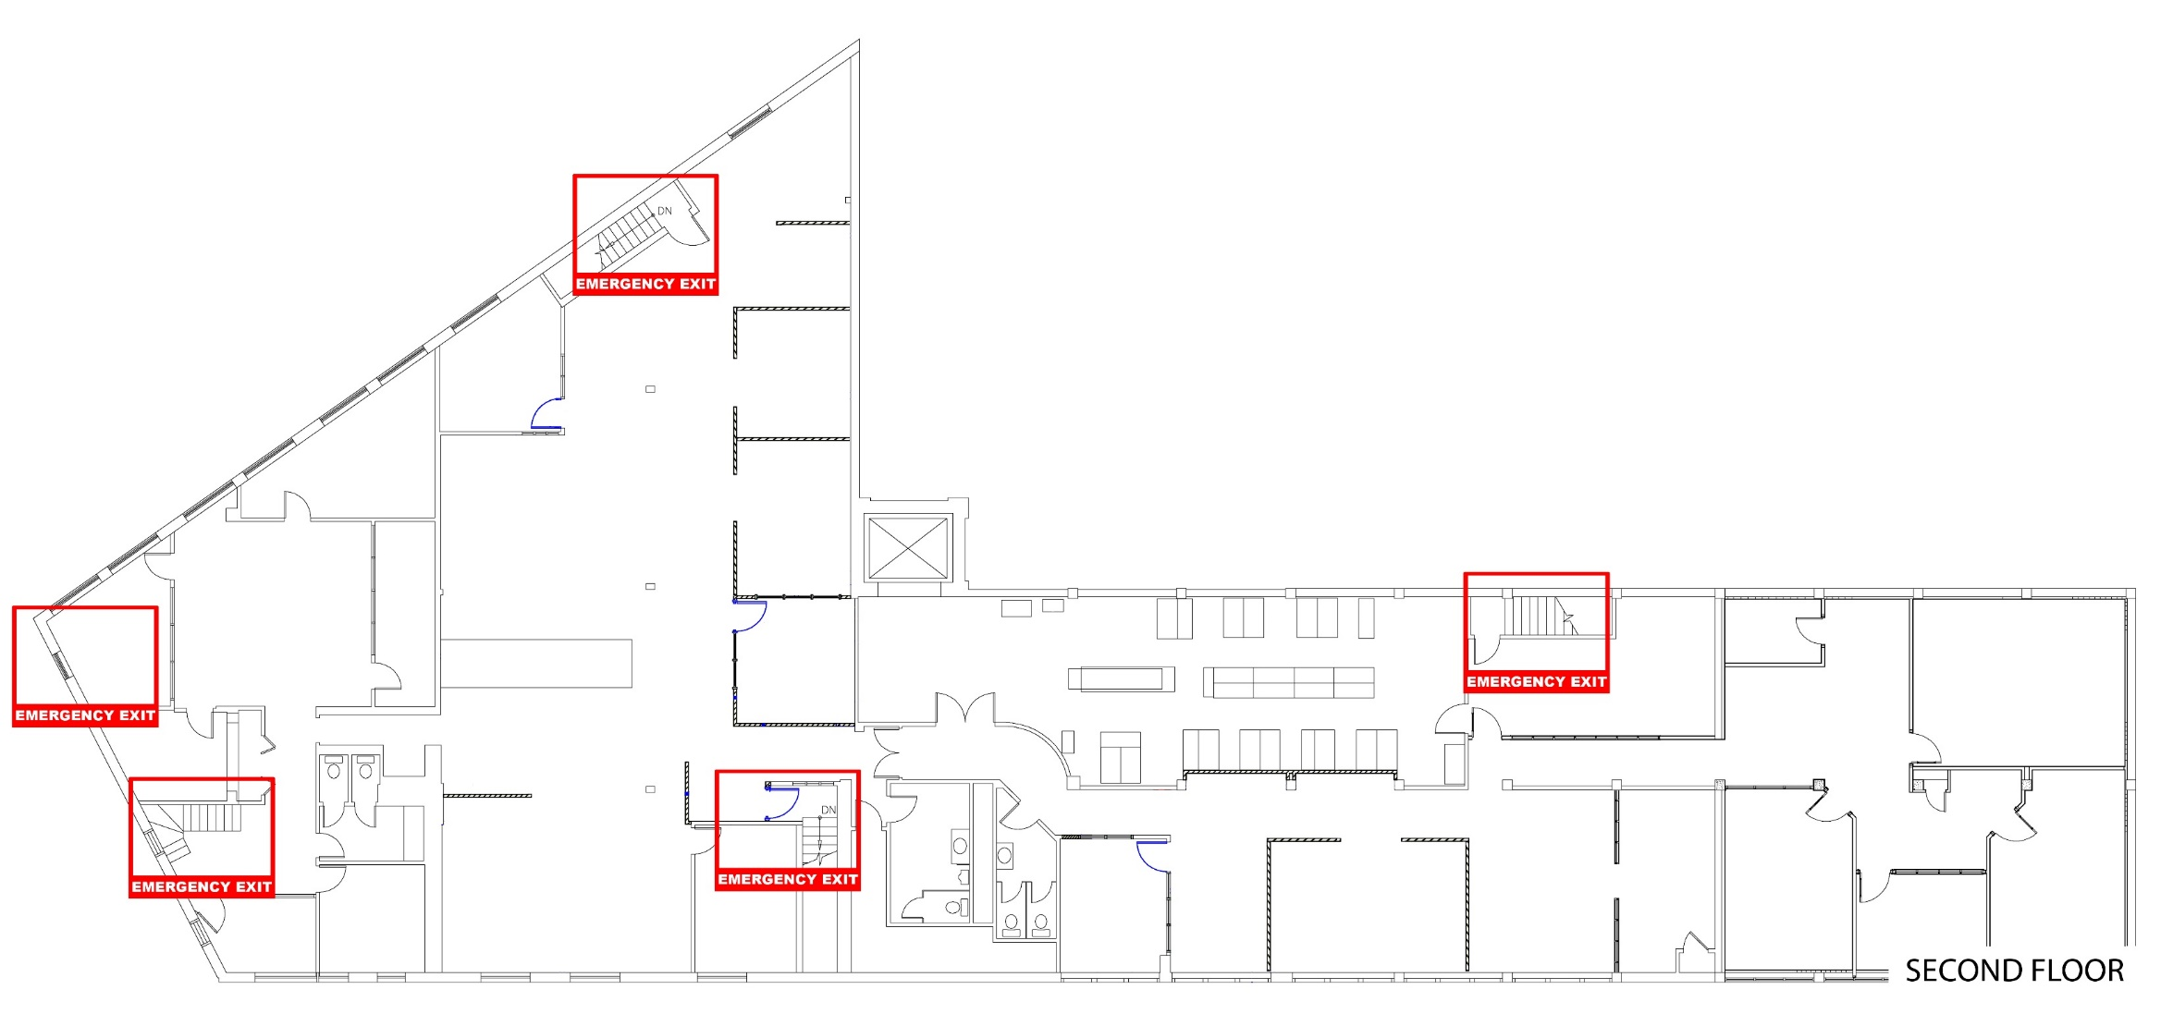
Admin Group:
Admin Group – exit through the Cafeteria and down the back fire exit stairs, through the Library to the Admiral Street exit. Exit #6 to Exit #2.
HR Manager will clear the Conference/Training Room, Admin offices and Cafeteria.

Slide 5
Credit & Accounting Group –
The Credit & Accounting team - exit through the cafeteria, down the back exit stairs and through the library to the Admiral Street exit.
Credit Manager will clear the ladies restroom, close doors in the hallway and clear the second floor storage area. Exit #6 to Exit #2

Slide 6
Inland Group – Exit down the main front entrance stairway and exit to Admiral Street. Exit #5 to Exit #1
VP of Inland Fuel will clear the inland conference, coffee station, men’s restroom and copier area

Slide 7
West End Group - Exit down the side stairs and exit out the front main entrance onto Admiral Street. Exit #8 to Exit #1
(The fire escape window can be used if no other way out is available.)
President of Santa Fuel will clear the West End offices and server room.

Slide 8
Buckley & Sales Group – Exit via the back emergency exit stairway to Harbor Street. Gather at Admiral St. sidewalk.
Sales Manager will clear all offices and cubicles on the way out. Exit #7

Slide 9
Location of important equipment –
Water supply for sprinkler system – Located in the Dunbar Side of the building, Admiral street entrance.
Gas shut off – Located behind the building at the gas meters, Pine Street.
Water shut off – Located in the Dunbar side of the building, Admiral Street entrance.
Electrical panels – First floor electrical room off of cafeteria.
Sonitrol emergency system panel – First floor electrical room off of cafeteria.
Main server area – On the west end of the 2nd floor, room is glass enclosed with a secured entrance door. Contact IT department for entry.
Roof access-way – Located on the Admiral Street side, between the front stairs and men’s restroom.
Elevator motor room – Located on top of the building, use roof access then motor room is the tallest grey structure with double steel doors.

